Slide 1

Vellore Institute OF Technology, BHOPAL
Fundamentals In AI & ML
(Department of Computer Science & Engineering)
Sonam Goswami
Vellore Institute Of Technology (VIT), Bhopal, India

Slide 2
Module-3 Knowledge Representation

Slide 3
Propositional Logic:
Propositional logic (PL) is the simplest form of logic where all the statements are made by propositions. A proposition is a declarative statement which is either true or false. It is a technique of knowledge representation in logical and mathematical form.
Alphabet Set:
Set of variables or propositional symbols P,Q,R
Logical constants – True (T), False(F)
Two Parentheses – “(“and”)”
Set of logical operators

Slide 4
Word | Symbol | Example
not | ¬ | ¬ X
and | ∧ | X ∧ Y
or | ∨ | X ∨ Y
Implies | → | X → Y (if X then Y)
If and only | ⇔ | X ⇔ Y
Example: Sentences
X: It is hot
Y: It is humid
Z: It is raining
If it is humid then it is hot
Sol. (Y→ X)

Slide 5
If it is hot and humid then it is not raining
Sol. (X ∧ Y) → ¬ Z
{ All, Some}
In this case, the Propositional logic is not used

Slide 6
What is First Order Logic?
FOL is a mode of representation in Artificial Intelligence. It is an extension of PL.
FOL represents natural language statements in a concise way.
FOL is also called predicate logic. It is a powerful language used to develop information about an object and express the relationship between objects.
FOL not only assumes that does the world contains facts (like PL does), but it also assumes the following:
Objects: A, B, people, numbers, colors, wars, theories, squares, pit, etc.

Slide 7
First Order Predicate Logic :
First Order Logic (FOL) can be simply put as a collection of objects, their attributes and relations among them to represent knowledge. It is also known as Predicate Logic.
First-order logic is another way of knowledge representation in artificial intelligence. It is an extension to propositional logic. FOL is sufficiently expressive to represent the natural language statements in a concise way. First-order logic is also known as Predicate logic or First-order predicate logic.

Slide 8
Relations: It is unary relation such as red, round, sister of, brother of, etc.
Function: father of, best friend, third inning of, end of, etc.

Slide 9
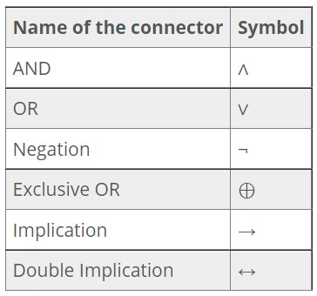
Representing Simple Statements in FOL:
It is important that you know the logical operators/connectives that are used in Propositional Logic.

Slide 10
Parts of First Order Logic:
FOL also has two parts:
Syntax
Semantics
Syntax: The syntax of FOL decides which collection of symbols is a logical expression. The basic syntactic elements of FOL are symbols. We use symbols to write statements in shorthand notation.

Slide 11
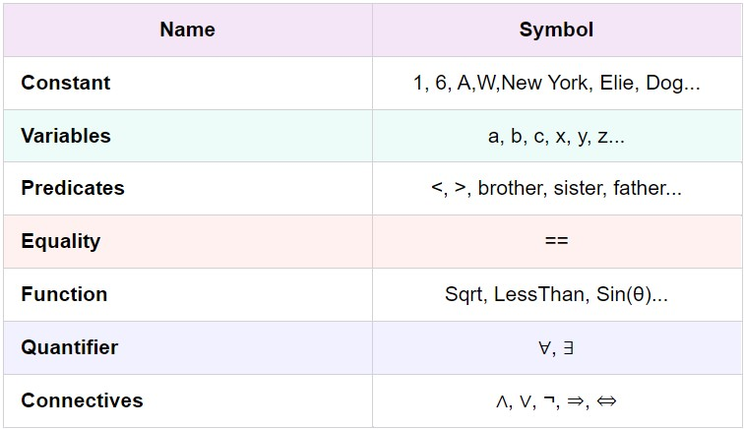
Basic Elements of FOL:

Slide 12
Atomic and Complex Sentences in FOL:
Atomic Sentence:
This is a basic sentence of FOL formed from a predicate symbol followed by a parenthesis with a sequence of terms.
We can represent atomic sentences as a predicate (value1, value2…., value n).
Example-
John and Michael are colleagues→ colleagues (John, Michael)
German Shepherd is a dog→ Dog (German Shepherd )

Slide 13
Complex Sentence:
Complex sentences are made by combining atomic sentences using connectives.
FOL is further divided into two parts:
Subject: the main part of the statement.
Predicate: defined as a relation that binds two atoms together.
Example-
“x is an integer”

Slide 14
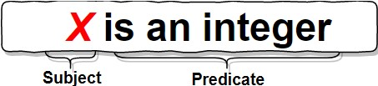
It has two parts;
First, x is the subject.
Second, “is an integer” is called a predicate.

Slide 15
Quantifiers and their use in FOL:
Quantifiers generate quantification and specify the number of specimen in the universe.
Quantifiers allow us to determine or identify the range and scope of the variable in a logical expression.
There are two types of quantifiers:
Universal quantifier: for all, everyone, everything.
Existential quantifier: for some, at least one.

Slide 16
Universal Quantifiers:
Universal quantifiers specify that the statement within the range is true for everything or every instance of a particular thing.
Universal quantifiers are denoted by a symbol
that looks like an inverted A. In a universal quantifier, we use
If x is a variable then, can read as:
For all x
For every x
For each x

Slide 17
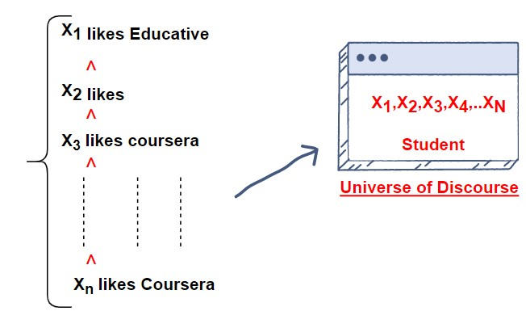
Example-
Every student likes educative.

Slide 18
Explanation:
So, in logical notation, it can be written as:
This can be interpreted as: There is every x where x is a student who likes Educative.
Existential Quantifiers:
Existential quantifiers are used to express that the statement within their scope is true for at least one instance of something.
which looks like an inverted E, is used to represent them. We always use AND or conjunction symbols.

Slide 19

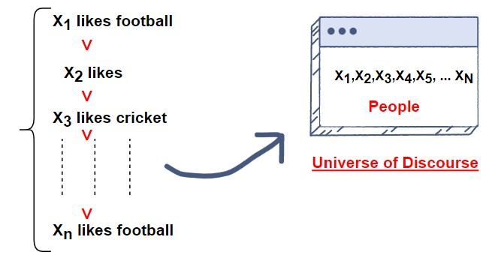
If x is a variable, the existential quantifier will be
For some x
There exists an x
For at least one x
Example-
Some people like Football.

Slide 20
Explanation:
So, in logical notation, it can be written as:
It can be interpreted as: There are some x where x is people who like football.

Slide 21
Difference between Propositional Logic and Predicate Logic
Propositional Logic | Predicate Logic
1. Propositional logic is the logic that deals with a collection of declarative statements which have a truth value, true or false. | 1. Predicate logic is an expression consisting of variables with a specified domain. It consists of objects, relations and functions between the objects.
2. It is the basic and most widely used logic. Also known as Boolean logic. | 2. It is an extension of propositional logic covering predicates and quantification.
3. A proposition has a specific truth value, either true or false. | 3. A predicate’s truth value depends on the variables’ value.
4. It is a more generalized representation. | It is a more specialized representation.

Slide 22
Propositional Logic | Predicate Logic
5. It cannot deal with sets of entities. | 5. It can deal with set of entities with the help of quantifiers.
6. Scope analysis is not done in propositional logic. | 6. Predicate logic helps analyze the scope of the subject over the predicate. There are three quantifiers : Universal Quantifier (∀) depicts for all, Existential Quantifier (∃) depicting there exists some and Uniqueness Quantifier (∃!) depicting exactly one.
7. Propositions are combined with Logical Operators or Logical Connectives like Negation(¬), Disjunction(∨), Conjunction(∧), Exclusive OR(⊕), Implication(⇒), Bi-Conditional or Double Implication(⇔). | 7. Predicate Logic adds by introducing quantifiers to the existing proposition.

Slide 23
FOPL Examples:
All boys like cricket
∀x: boys(x)→ like (x, cricket)
Some boys like football
∃x: boys(x) ∧ like (x, football)
Some girls hate football
∃x: girls(x) ∧ hate (x, football)

Slide 24
All girls love Pink
∀x: girls(x)→ love (x, Pink)
Every person who buys a policy is smart
∀x∀y : Person(x) ∧ Policy(y) ∧ buys(x,y)→ smart(x)
No person buys expensive Policy
∀x∀y : Person(x) ∧ Policy(y) ∧ expensive(y) →
¬ buys(x,y)

Slide 25
Knowledge c:
Knowledge Representation and Reasoning (KR, KRR) represents information from the real world for a computer to understand and then utilize this knowledge to solve complex real-life problems like communicating with human beings in natural language.
The different kinds of knowledge that need to be represented in AI include:
Objects
Events
Performance
Facts
Meta-Knowledge
Knowledge-Base

Slide 26
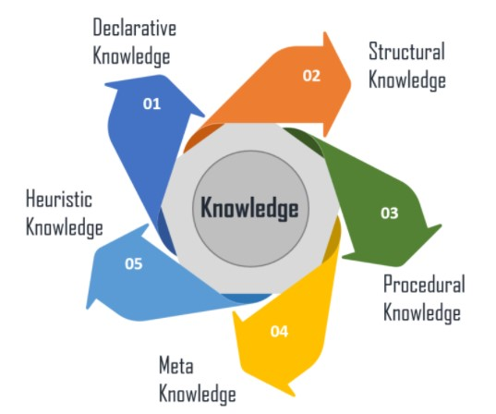
Different Types of Knowledge:
There are 5 types of knowledge such as:

Slide 27
Cycle of Knowledge Representation:
Artificial Intelligent Systems usually consist of various components to display their intelligent behaviour. Some of these components include:
Perception
Learning
Knowledge Representation & Reasoning
Planning
Execution

Slide 28
Declarative knowledge- It includes concepts, facts, and objects and expressed in a declarative sentence.
Structural knowledge- It is a basic problem-solving knowledge that describes the relationship between concepts and objects.
Procedural Knowledge – This is responsible for knowing how to do something and includes rules, strategies, procedures, etc.
Meta Knowledge – Meta Knowledge defines knowledge about other types of Knowledge.
Heuristic Knowledge – This represents some expert knowledge in the field or subject.

Slide 29
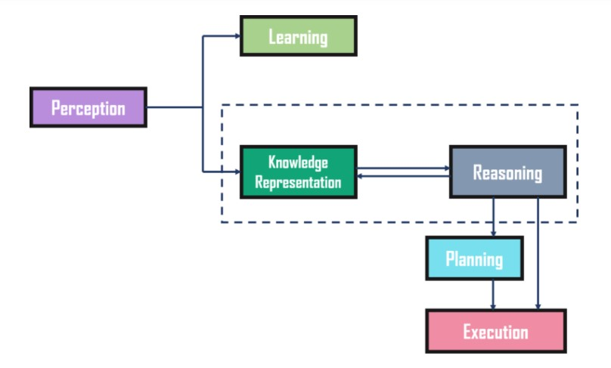
Here is an example to show the different components of the system and how it works:
Example:
Notes:
This diagram shows the interaction of the A.I. system with the real-world and the components involved and showing the intelligence.
So perception retrieves data or info. From the environment. With the help of this component you can retrieve data from the environment find out the sources of noises and check if the A.I. damaged by anything also it defines how to respond when any sense has been detected.
Now next component is Learning component: This learns from the captured data by the perception component here the goal is to build the computers that can be taught instead of programming them. Learning focuses on self improvement in order to learn new things this system requires knowledge acquisition, inference, faster searches, etc.
Now these are the main components in the cycle i.e., Knowledge representation and Reasoning: This shows human like Intelligence in the machines KR is all about understanding Intelligence. Its goal is to understand and built intelligence behaviour from the top-down and focus on what's an agent needs to know in intelligently.
Now Planning and Execution: These components depends on the analysis of knowledge representation and reasoning here planning includes giving initial states, finding the preconditions and effects. Sequence of actions to achieve states in which a particular goal hole. Now once planning is completed then final stage is the execution for the entire process So this is all about the cycle of knowledge representation in A.I.

Slide 30
Relation Between Knowledge and Intelligence:
In the real world, knowledge plays a vital role in intelligence as well as creating artificial intelligence. It demonstrates the intelligent behaviour in AI agents or systems. It is possible for an agent or system to act accurately on some input only when it has the knowledge or experience about the input.

Slide 31
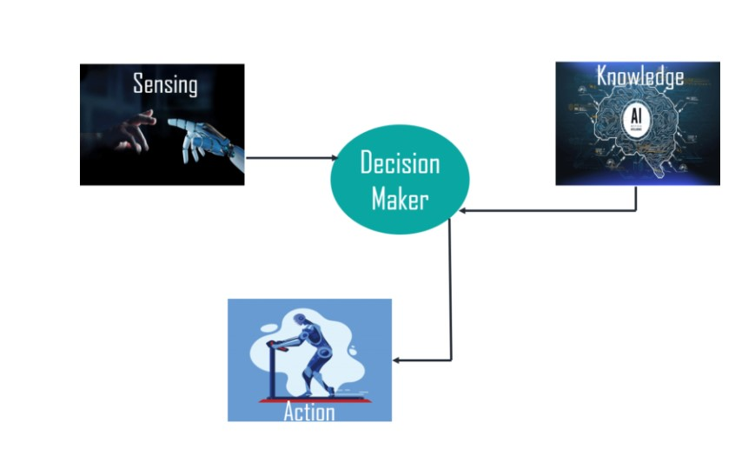
Notes:
Here one decision maker whose actions are justified by sensing the environment and using knowledge. But if you remove this knowledge apart from here it will not to be able to display any intelligent behaviour so this is the relationship b/w knowledge & Intelligence. You need knowledge in order to display any intelligent behaviour that is for any Intelligent system you need knowledge first.

Slide 32
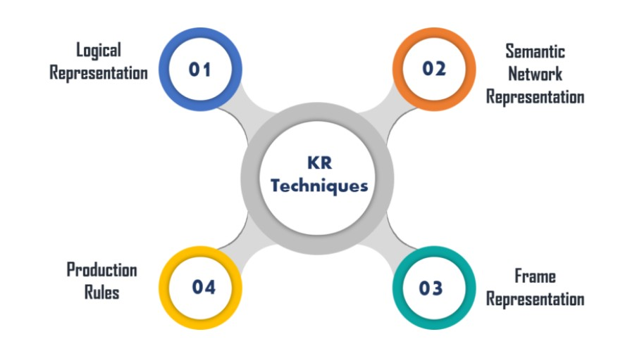
Techniques of Knowledge Representation:

Slide 33
Logical Representation: Logical Representation is a language with some definite rules which deals with propositions and has no ambiguity in representation. It represents a conclusion based on various conditions and lays down some important communication rules.

Slide 34
Syntax | Semantics
It decides how we can construct legal sentences in logic. | Semantics are rules by which we can interpret the sentence in the logic.
It determines which symbol we can use in knowledge representation. | It assigns a meaning to each sentence.
Also, how to write those symbols.

Slide 35
Advantages:
Logical representation helps to perform logical reasoning.
This representation is the basis for the programming languages.
Disadvantages:
Logical representations have some restrictions and are challenging to work with.
This technique may not be very natural, and inference may not be very efficient.

Slide 36





















Components of Semantic Networks:
Lexical Component- Nodes, Links, Labels
Structural Component- Links, Nodes
Semantic Component- It shows definition related to link or nodes. It basically represents the facts.
Procedural Component-
Constructor Level
Destructor Level

Slide 37
Advantages | Disadvantages
Semantic networks are a natural representation of knowledge. | Semantic networks take more computational time at runtime.
Also, it conveys meaning in a transparent manner. | Also, these are inadequate as they do not have any equivalent quantifiers.
These networks are simple and easy to understand. | These networks are not intelligent and depend on the creator of the system.

Slide 38















Frame Representation:
A frame is a record like structure that consists of a collection of attributes and values to describe an entity in the world.

Slide 39
Advantages | Disadvantages
It makes the programming easier by grouping the related data. | In frame system inference, the mechanism cannot be easily processed.
Frame representation is easy to understand and visualize. | The inference mechanism cannot be smoothly proceeded by frame representation.
It is very easy to add slots for new attributes and relations. | It has a very generalized approach.

Slide 40
There are certain attributes that are attached with each slot-
Instance- It relates the slot with the class.
Definition- Slot Def./value
Default- Slot Default value
Domain- Slots elements Domain
Range- Specify the class of which elements
Range Constrain- It is a logical expression. Eg. 6<i<10
To-Complete- Value of slot is to be completed.
Single valued- Function returns single value
Inverse- Slot inverse which is used in reasoning.
Transfer Through- It is used in Inheritance.

Slide 41
4. Production Rules:
In production rules, agent checks for the condition and if the condition exists then production rule fires and corresponding action is carried out. The condition part of the rule determines which rule may be applied to a problem. Whereas, the action part carries out the associated problem-solving steps. This complete process is called a recognize-act cycle.
The production rules system consists of three main parts:
The set of production rules
Working Memory
The recognize-act-cycle

Slide 42
Examples of Production Rules:
IF (at bus stop AND bus arrives) THEN action (get into the bus)
IF (on the bus AND paid AND empty seat) THEN action (sit down).
IF (on bus AND unpaid) THEN action (pay charges).
IF (bus arrives at destination) THEN action (get down from the bus).

Slide 43
Advantages | Disadvantages
The production rules are expressed in natural language. | It does not exhibit any learning capabilities and does not store the result of the problem for future uses.
The production rules are highly modular and can be easily removed or modified. | During the execution of the program, many rules may be active. Thus, rule-based production systems are inefficient.

Slide 44
Ontological Engineering:
A set of concepts and categories in a subject area or domain that shows their properties and the relations between them
Ontology engineering is a set of tasks related to the development of ontologies for a particular domain.
It allows the reuse of knowledge in a knowledge base by providing conceptualization, reflecting assumptions and requirements made in the problem solving using the knowledge base. Ontology engineering provides the means to build and use ontologies for building models.

Slide 45
The word itself and its origin:
The word ontology comes from two Greek work
“onto” = existence, or being real
“logia” = science, or study
The word is used in two settings
The ontology is used in both in philosophical and non philosophical context.

Slide 46
Ontology vs Knowledge Base:
“The Artificial- Intelligence literature contains many definitions of an ontology; many of these contradict one another…An ontology together with a set of individual instances of classes constitutes a knowledge base. In reality, there is a fine line where the ontology ends and the knowledge base begins.”

Slide 47
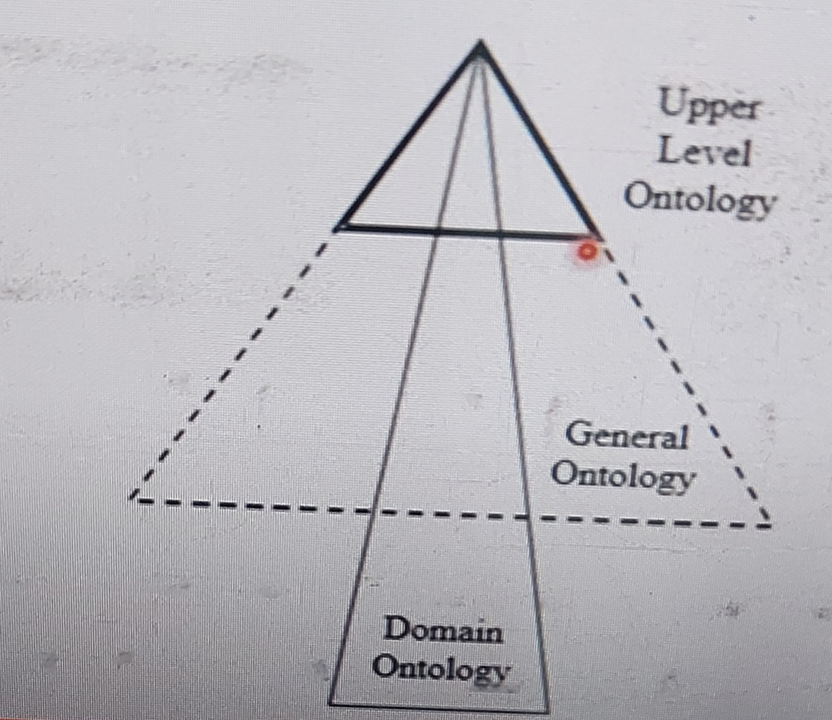
Types of Ontologies:

Slide 48
Upper Ontology:
An upper Ontology- also called top-level ontology or foundation ontology- describes the most general concepts that are same across all knowledge domains. (e.g. Entity).
General Ontologies:
General Ontologies represent knowledge at an intermediate level of detail independently of a specific task.. Theories of time and space.

Slide 49
Domain Level Ontologies:
…Ontologies designed for specific tasks are called application ontologies. Conversely, reference ontologies are developed independently of any particular purpose.

Slide 50
Categories and Objects:
The organization of objects into categories.
Much reasoning takes place at the level of categories.
For example, a shopper would normally have the goal of buying a basketball, rather than a particular basketball such as BB9.
Categories also serve to make predictions about objects once they are classified.
Representation of categories in first-order logic:
Predicates e.g. Basketball(b)
Objects e.g. Basketball

Slide 51
Categories:
Categories serve to organize and simplify the knowledge base through inheritance.
Subclass relations organize categories into a taxonomy, or taxonomic hierarchy
Subset(Basketball, Balls)

Slide 52
Example:
An object is a member of a category.
BB9 ∈ Basketballs
A category is a subclass of another category.
Basketballs C Balls
All members of a category have some properties.
(x ∈ Basketballs) ⇒ Spherical (x)
Members of a category can be recognized by some properties.
Orange(x) ∧ Round(x) ∧ Diameter(x) = 9.5 ∧ x ∈ Balls ⇒ x ∈ Basketballs
A category as a whole has some properties.
Dogs ∈ Domesticated Species

Slide 53
Objects:
The real-world can be seen as consisting of primitive objects (e.g., atomic particles) and composite objects built from them.
Stuff
Things
Some Properties are Intrinsic: they belong to very substance of the objects, rather than to the object as a whole.
Extrinsic properties- Weight, length, shape, and so on- are not retained under subdivision.
A category of objects that includes in its destination only intrinsic properties is then a substance, or mass noun; a class that includes any extrinsic properties in its definition is a count noun.

Slide 54
Mental Events
A mental event is any event that happens within the mind of conscious individual such as thoughts, feelings, decisions, dreams and realizations.
Example- Mary feels happy after doing well on an exam and she smiles. This thought is a mental event while the smile is physical event.
A killer whale recognized a feeling of hunger. It eats a fish. The recognition of the feeling of hunger is a mental event. Eating the fish is physical event.

Slide 55
Mental Events and Mental Objects:
Knowledge about one’s own knowledge and reasoning processes is useful for controlling the Inference.
The agent should know what are in its knowledge base and what are not
What we need is a model of the mental objects that are in someone’s hear (or some-thing’s knowledge base) and of the mental processes that manipulate those mental objects.
Propositional attitudes that an agent can have toward mental objects: attitudes such as Believes, Knows, Wants, Intends and Informs.

Slide 56
Monotonic Reasoning:
Once the conclusion is taken, then it will remain same even if we add some information to existing information in our knowledge base.
Decision are not affected by new facts, not suitable for real time system.
Example-
Earth revolves around the sun.
Earth is not Round- new information.

Slide 57
All old proofs are valid.
Can’t use for real-world problem.
New knowledge from real world can’t be added.
Example- Theorem Proving.

Slide 58
Non-Monotonic Reasoning:
In Non-monotonic reasoning, some conclusions may be invalidated if we add some more information to our knowledge base. Logic will be said as non-monotonic if some conclusions can be invalidated by adding more knowledge into our knowledge base. Non-monotonic reasoning deals with incomplete and uncertain models.
“Human perceptions for various things in daily life, "is a general example of non-monotonic reasoning.

Slide 59
Example: Let suppose the knowledge base contains the following knowledge:
Birds can fly
Penguins cannot fly
Pitty is a bird
Conclusion: Pitty can Fly

Slide 60
Example-
Facts:
Birds can fly.
Penguins can’t fly.
Pitty is a bird.
Conclusion: Pitty Can’t Fly.
Disadvantages: Can’t used for theorem proving
Example- Robot Navigation

Slide 61





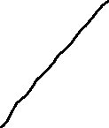




Example-
Penguin cannot Fly
Birds has wings
Birds can Fly
Penguin is a bird
Conclusion: Penguin can Fly

Slide 62
Advantages | Disadvantages
For real-world systems such as Robot navigation, we can use non-monotonic reasoning. | In non-monotonic reasoning, the old facts may be invalidated by adding new sentences.
In Non-monotonic reasoning, we can choose probabilistic facts or can make assumptions. | It cannot be used for theorem proving.

Slide 63
Logics for Non-monotonic Reasoning:
Default logic can express facts like “by default, something is true”; by contrast, standard logic can only express that something is true or that something is false. This is a problem because reasoning often involves facts that are true in the majority of cases but not always.
Example is:
“birds typically fly”. This rule can be expressed in standard logic either by “all birds fly”, which is inconsistent with the fact that are not penguins and not ostriches and…. Fly”, which requires all exceptions to the rule to be specified.
Default logic aims at formalizing inference rules like this one without explicitly mentioning all their exceptions.

Slide 64
Default Logic:
For example
A:B
C
Read as “If A is provable and it is consistent to assume B then conclude C”.

Slide 65
Example-
The Default rule “birds typically fly” is formalized by the following default:
D = {Bird(X): Flies(X)}
Flies(X)
This rules means that, “if X is a bird, and it can be assumed that it flies, then we can conclude that it flies”. A background theory containing some facts about birds is the following one:
W = {Bird(Condor), Bird(Penguin),¬ Flies (Penguin), Flies(Bee)}.

Slide 66
What is Default Reasoning?
Q. How many wheels of Johan’s car have?
Ans. 4
The Conclusion is withdrawn if one supplied with the information that one wheel of john’s car has just been stolen
Non monotonicity

Slide 67
Approaches of Default Reasoning:
Non Monotonic Logic:
Truth of proposition may change when new information are added and logic may be built to allow the statement to be retracted.
Use Model Operator M
M is used for to allow consistency
Example-
∀x:plays_instrument(x) AND M Manages(x) ->johns_musician(x)

Slide 68
Default Logic:
For example
A:B
C
Where,
A = Pre requisite
B = Justification
C = Consequent

Slide 69
Forward Chaining and Backward Chaining in AI:
Inference Engine:
The inference engine is the component of the intelligent system in artificial intelligence, which applies logical rules to the knowledge base to infer new information from known facts. The first inference engine was part of the expert system. Inference engine commonly proceeds in two modes, which are:
Forward Chaining
Backward Chaining

Slide 70
Forward Chaining:
Forward chaining is also known as a forward deduction or forward reasoning method when using an inference engine. Forward chaining is a form of reasoning which start with atomic sentences in the knowledge base and applies inference rules (Modus Ponens) in the forward direction to extract more data until a goal is reached.
The Forward-chaining algorithm starts from known facts, triggers all rules whose premises are satisfied, and add their conclusion to the known facts. This process repeats until the problem is solved.

Slide 71
Properties of Forward Chaining:
It is a down-up approach, as it moves from bottom to top.
It is a process of making a conclusion based on known facts or data, by starting from the initial state and reaches the goal state.
Forward-chaining approach is also called as data-driven as we reach to the goal using available data.
Forward -chaining approach is commonly used in the expert system, such as CLIPS, business, and production rule systems.

Slide 72
Advantages:
It can be used to draw multiple conclusions.
It provides a good basis for arriving at conclusions.
It’s more flexible than backward chaining because it does not have a limitation on the data derived from it.
Disadvantages:
The process of forward chaining may be time-consuming. It may take a lot of time to eliminate and synchronize available data.
Unlike backward chaining, the explanation of facts or observations for this type of chaining is not very clear. The former uses a goal-driven method that arrives at conclusions efficiently.

Slide 73
Example of Forward Chaining:
When based on available data a decision is taken then the process is called as the forward chaining.
It works from initial state and reaches to goal state.

Slide 74
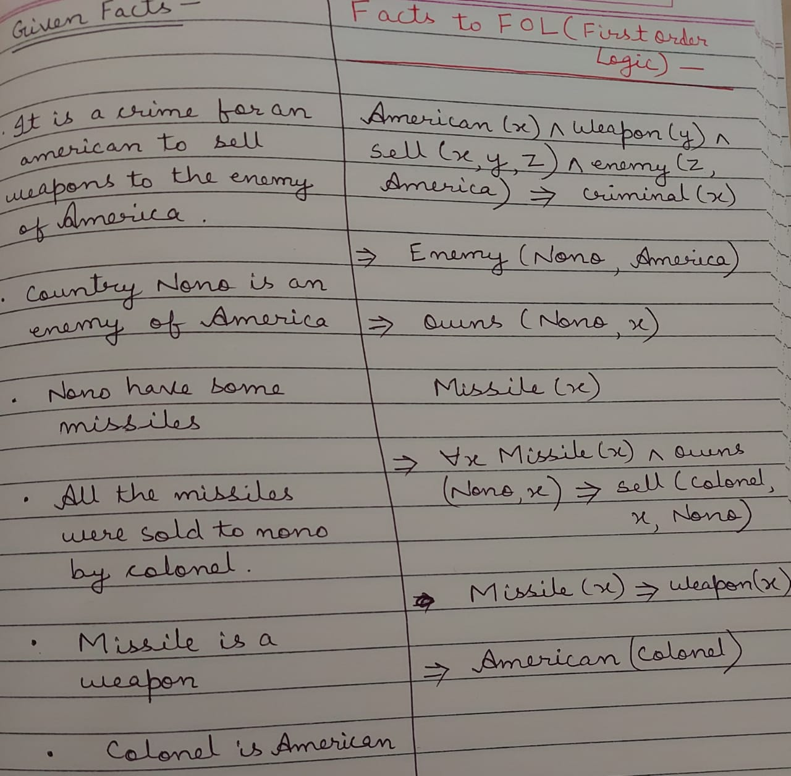

Slide 75
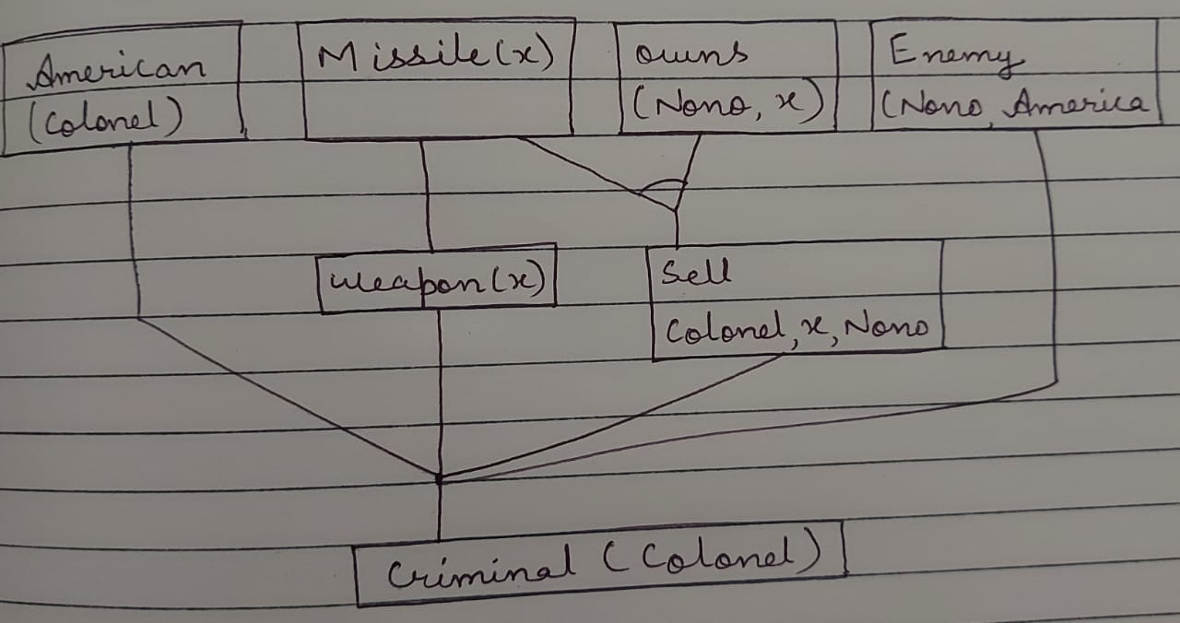
Proof by Forward Chaining:

Slide 76
Backward Chaining:
Backward-chaining is also known as a backward deduction or backward reasoning method when using an inference engine. A backward chaining algorithm is a form of reasoning, which starts with the goal and works backward, chaining through rules to find known facts that support the goal.

Slide 77
Properties of Backward Chaining:
It is known as a top-down approach.
Backward-chaining is based on modus ponens inference rule.
In backward chaining, the goal is broken into sub-goal or sub-goals to prove the facts true.
It is called a goal-driven approach, as a list of goals decides which rules are selected and used.
Backward -chaining algorithm is used in game theory, automated theorem proving tools, inference engines, proof assistants, and various AI applications.
The backward-chaining method mostly used a depth-first search strategy for proof.

Slide 78
Advantages:
The result is already known, which makes it easy to deduce inferences.
It’s a quicker method of reasoning than forward chaining because the endpoint is available.
In this type of chaining, correct solutions can be derived effectively if pre-determined rules are met by the inference engine.

Slide 79
Disadvantages:
The process of reasoning can only start if the endpoint is known.
It doesn’t deduce multiple solutions or answers.
It only derives data that is needed, which makes it less flexible than forward chaining.

Slide 80
Backward Chaining Example-

Slide 81
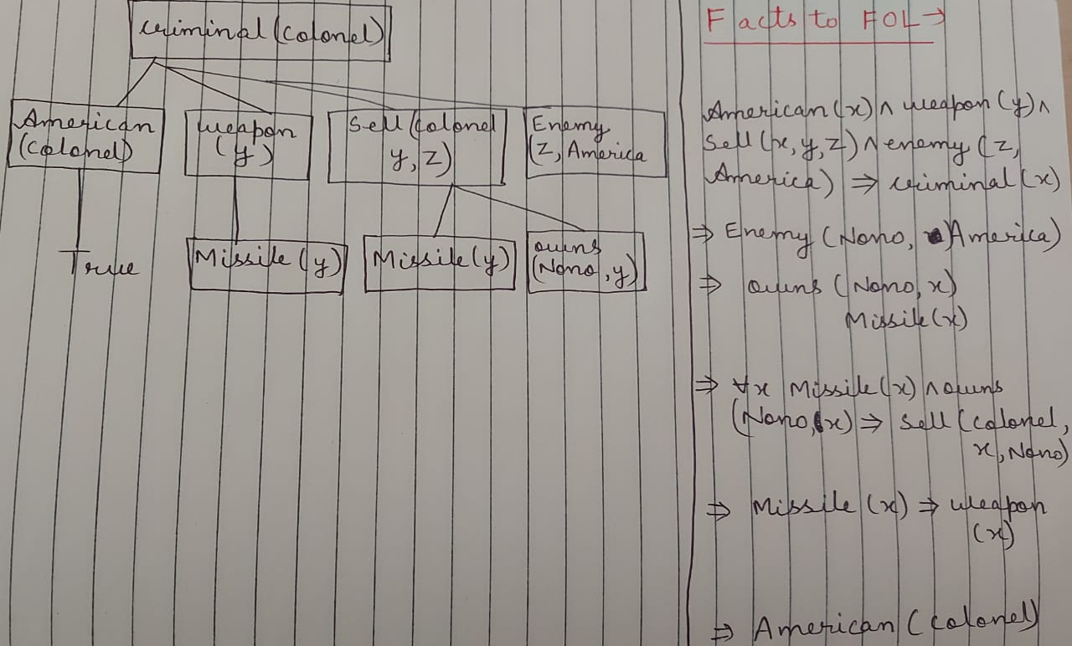

Slide 82
Resolution:
Resolution method is an inference rule which is used in both Propositional as well as First-order Predicate Logic in different ways. This method is basically used for proving the satisfiability of a sentence. In resolution method, we use Proof by Refutation technique to prove the given statement.

Slide 83
Example-
Prove Ravi likes Peanuts
FOL: likes (Ravi, Peanuts)
Steps:
Negate the statement to be proved
likes (Ravi, Peanuts)
Convert given Facts into FOL
Convert FOL into CNF (Conjunctive Normal Form) or (Closed Normal Form)
Draw Resolution Graph

Slide 84
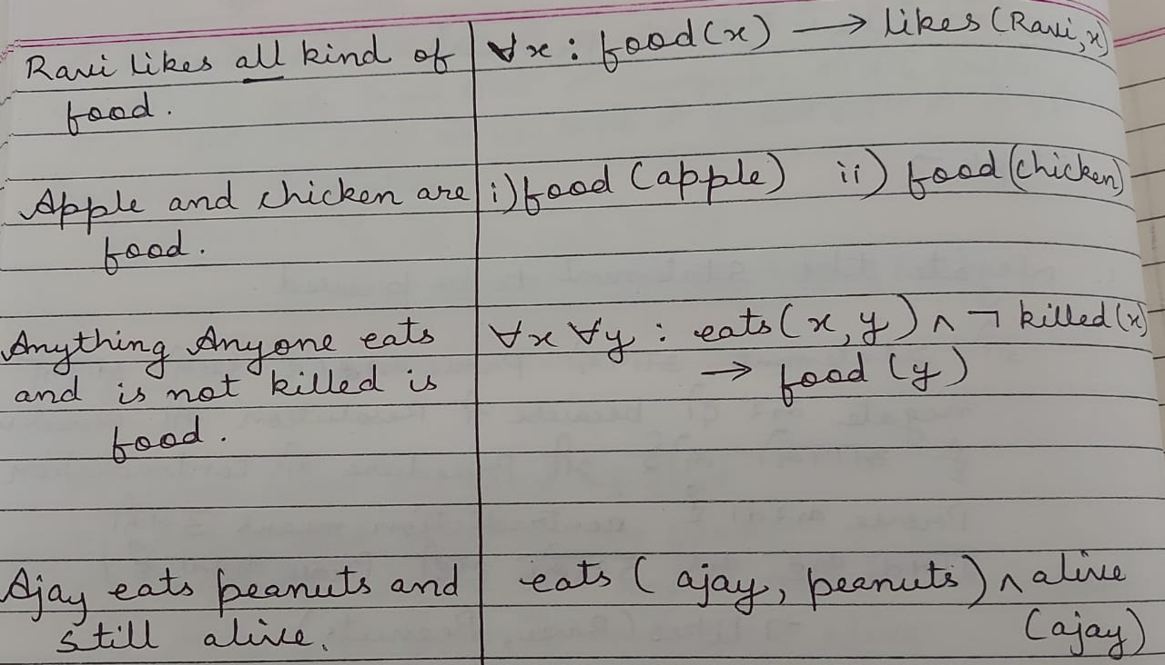
Convert into FOL:

Slide 85
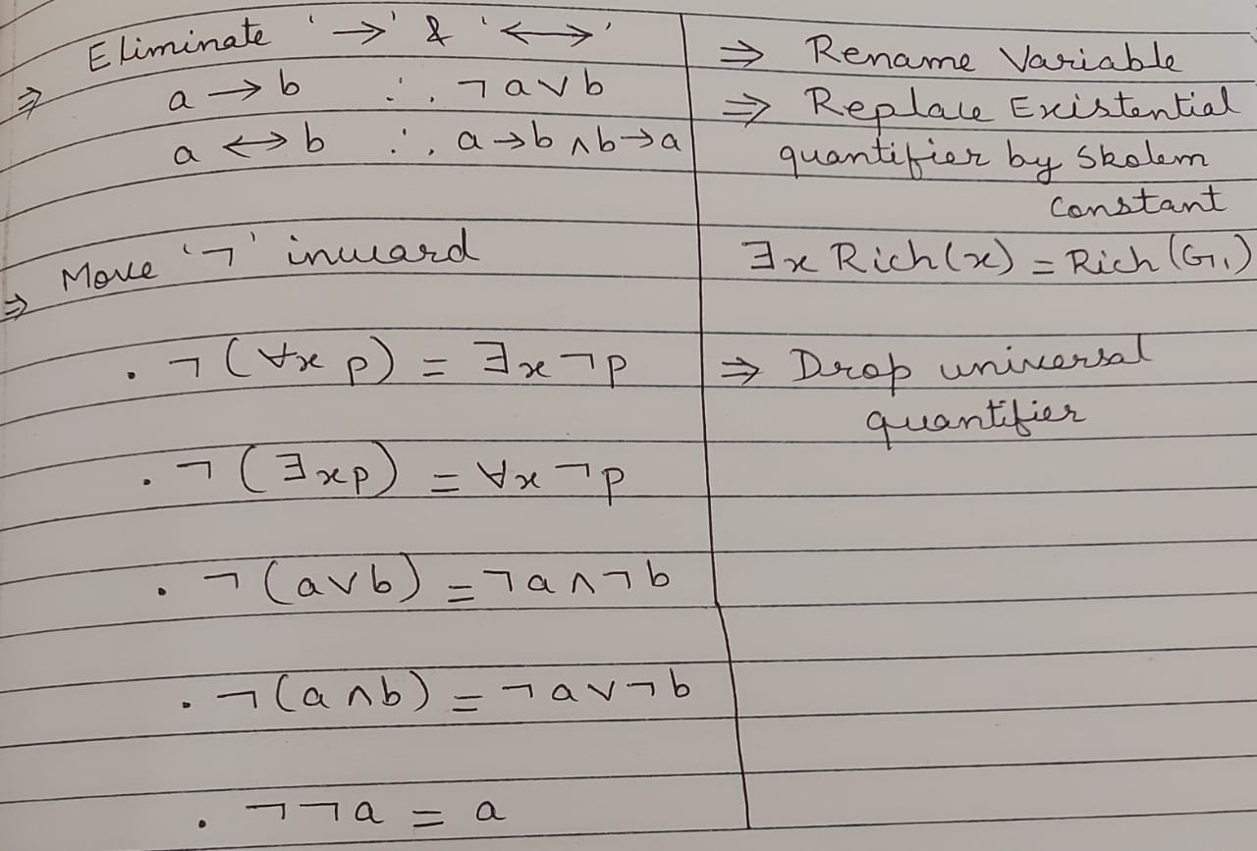
Rules to convert FOL into CNF:

Slide 86
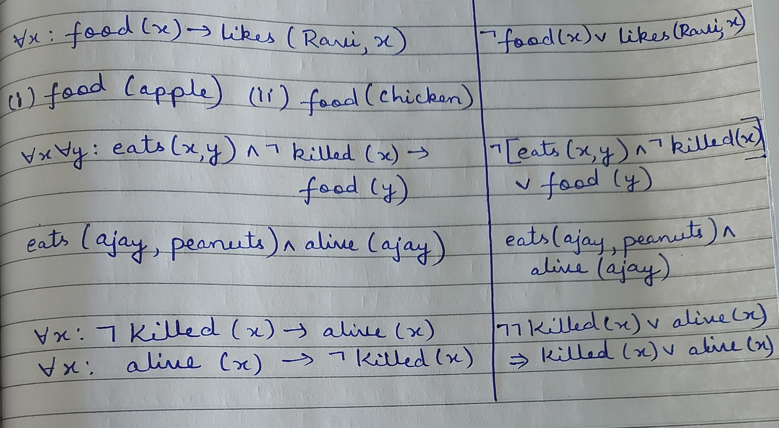
For example-

Slide 87
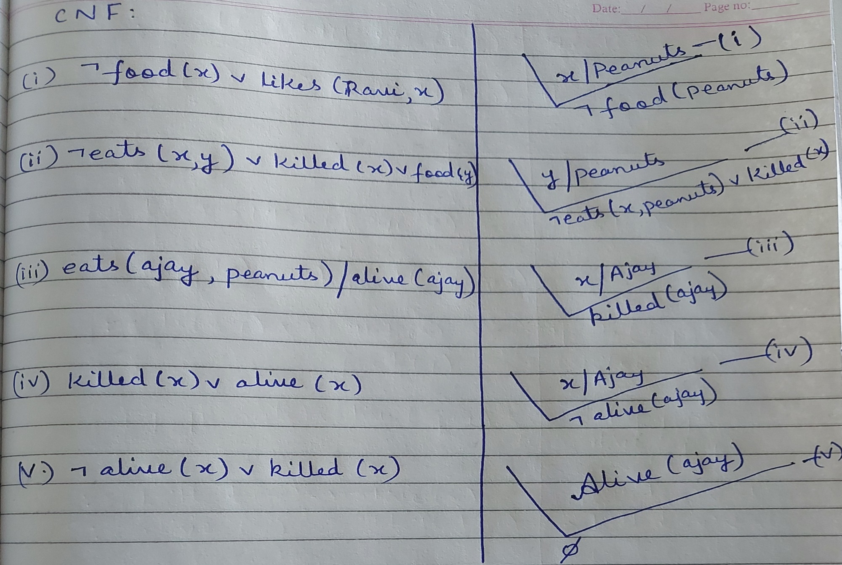
Resolution Graph:

Slide 88
Prolog:
Prolog (Programming in logic) is one of the most widely used programming languages in artificial intelligence research. As opposed to imperative languages such as C or Java(which also happens to be object-oriented) it is a declarative programming language.
Prolog is very useful in some problem areas, like artificial intelligence, natural language processing, databases, etc…, but pretty useless in others, like graphics or numerical algorithms.

Slide 89
Programming in Prolog means describing the world. Using such programs means asking Prolog questions about the previously described world. The simplest way of describing the world is by stating facts, like this one:
bigger( elephant, horse).
This states, the fact that an elephant is bigger than a horse. (Whether the world described by a Prolog program has anything to do with our real world is of course entirely up to the programmer.)

Slide 90
Let’s add a few more facts to our little program:
bigger( elephant, donkey).
bigger( horse, donkey).
bigger( donkey, dog).
bigger( donkey, monkey).
After having compiled it we can ask the Prolog system questions (or queries in proper Prolog-jargon) about it. Here’s an example:
?- bigger( donkey, dog).

Slide 91
The query bigger( donkey, dog)(i.e. the question \Is a donkey bigger than a dog?”) succeeds, because the fact bigger( donkey, dog) has been communicated to the Prolog system before. Now, is a monkey bigger than an elephant?
?- bigger( monkey, elephant).
No
No, it’s not. We get exactly the answer we expected: the corresponding query namely bigger( monkey, elephant) fails.

Slide 92
Prolog Syntax:
Terms
The central data structure in Prolog is that of a term. There are of four kinds:
Atoms
Numbers
Variables and
Compound terms

Slide 93
Atoms
Atoms are usually strings made up of lower- and uppercase letters, digits and the underscore starting with the lowercase letter. The following are all valid Prolog atoms:
Atoms → elephant, b, abcXYZ, x_123
Also any series of arbitrary characters enclosed in single quotes denotes an atom.
‘This is also a Prolog atom.’

Slide 94
Numbers
Number can be in integer or in float.
Variables
Variables are strings of letters, digits and underscore, starting with a capital letter or an underscore.
Variables→ X, Elephant, _4711, X_1_2, MyVariable, _
The last one of the above examples (the single underscore) constitutes a special case. It is called the anonymous variable and is used when the value of a variable is of no particular interest.

Slide 95
Compound terms
Compound terms are made up of a functor (a Prolog atom) and a number of arguments (Prolog terms, i.e. atoms, numbers, variables, or other compound terms) enclosed in parenthesis and separated by commas. The following are some examples for compound terms:
is_bigger( horse, X), f(g(X,_),7), ‘My Functor’( dog)
It’s important not to put any blank characters between the functor and the opening parenthesis, or Prolog won’t understand what you’re trying to say.
In Prolog, the word functor is used to refer to the atom at the start of a structure, along with its arity, that is, the number of arguments it takes.

Slide 96
Clauses
Prolog programs are made up of facts and rules. Facts and rules are called clauses.
Facts
A fact is a predicate followed by a dot. And predicate is the name given to the word occurring before the bracket in a fact or rule.
Examples: bigger(cat, rat).
It can be read as cat is bigger then rat.
The intuitive meaning of a fact is that, we define a certain instance of the relation as being true.

Slide 97
Rules:
Rules allow us to understand that a property or relationship holds based on preconditions.
A rule consists of head (a predicate) and a body. (a sequence of predicates separated by commas). Head and body are separated by the sign :- and, like every Prolog expression, a rule has to be terminated by a dot.
Examples: For all X and Y
if X is a mother of Y then
X is a parent of Y
Here the prolog clauses is: parent(X,Y):-mother(X,Y). are called rules.
Head Body

Slide 98
There is important difference between fact and rules. A fact like parent(tom,liz). Is something that is always unconditionally true. On the other hand rules specify things that are true if some condition is satisfied.

Slide 99









3. Recursive Rules (predecessor relation)
This relation will be defined in terms of parent relation.
The whole definition can be expressed with two rules. The first rule will define the direct (immediate) predecessors and the second rule the indirect predecessors. We say that some X is an indirect predecessor of some Z if there is a parentship chain of people between X and Z as illustrated in figure below.

Slide 100





The first rule is simple and can be formulated as:
For all X and Z,
X is a predecessor of Z if
X is a parent of Z.
This is straightforwardly translated into Prolog as:
predecessor(X, Z) :- parent(X, Z)

Slide 101








The second rule can be formulated as:
For all X and Z.
X is a predecessor of Z if
there is a Y such that
X is a parent of Y and
Y is a predecessor/ parent of Z.
This is straightforwardly translated into Prolog as:
predecessor(X, Z) :- parent(X, Y), predecessor/parent(Y,Z).

Slide 102
Unification:
Unification is the process of finding a substitute that makes two separate logical atomic expressions identical. The substitution process is necessary for unification.
It accepts two literals as input and uses substitution to make them identical.
Let Ψ₁ and Ψ₂ be two atomic sentences, and be a unifier such that Ψ_{1𝜎} = Ψ_{2𝜎}, then UNIFY(Ψ₁, Ψ₂)can be written.
Example: Find the MGU for Unify{King(x), King(John)} Let Ψ₁ = King(x), Ψ₂ = King(John),

Slide 103
Conditions for Unification:
The following are some fundamental requirements for unification:
Atoms or expressions with various predicate symbols can never be united.
Both phrases must have the same number of arguments.
If two comparable variables appear in the same expression, unification will fail.

Slide 104
Simple E.g.-
P(x, F(y))--------------(1)
P(a, F(g(z))------------(2)
Eqn. (1) & (2) are identical if x is replace with a –
and y is replace with g(z)
P(a, F(g(z))
[a/x, g(z)/y]
It means x is replaced with a and y is replace with g(z)

Slide 105
Example-1:
Q (a, g(x, a), f(y)) , Q (a, g(f(b), a), x)
A1 A2
Substitute x with f(b) [f(b)/x]
Q(a, g(f(b), a), f(y)), Q(a, g(f(b),a), f(b))
Substitute (b/y) [y is substituted with b]
[Q(a, g(f(b), a), Q (a, g(f(b),a), f(b)]
Unified Successfully

Slide 106
Example-2:
Prime (11), Prime (y)
Substitute y with 11
Prime (11), Prime(11)
Unified Successfully

Slide 107
Thank you

